Slide 1
Quantitative Methods Lecture-5

Slide 2
Probability – Part II
(Ch 4 Business Statistics, Levine et al.)

Slide 3
So far and the next
Previous Sessions
Defining and collecting data
Survey and sampling methods
Organizing and visualizing variables
Numerical descriptive measures
Probability (Part I)
Today
Probability (Part II)

Slide 4
Two people
Every person can either be a Yes or a No
How many arrangements are possible
Yes, No
Yes, Yes
No, Yes
Yes, No

Slide 5
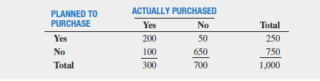
Sample space – some more exploration
Sample space depends on how you frame the experiment
Lets consider only one feature of the previous example
Frame 1: Nature generates a visitor out of its own magic with two possibilities
Sample space: S = {Yes, No}
Are these equally likely outcomes? Is probability P(Yes) = ½?
Frame 2: Equally likely sample space
Treat 1000 store visitors’ data like a pack of 1000 independent cards
Each card is marked as one of the two values (250: Yes, 750: No)
S= { 750-No, 250-Yes)
Nature randomly picks a card with replacement (every card is equally likely)
What is the probability that the next visitor plans to purchase?
Frame 3: Drawing 1000 independent persons from a population
Sample space - { All permutations of a thousand Yes or No possibilities}
Total: 2X2….X2 (1000 times) = 2¹⁰⁰⁰ values

Slide 6
Conditional probability

Slide 7
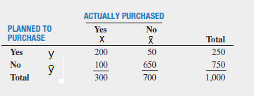
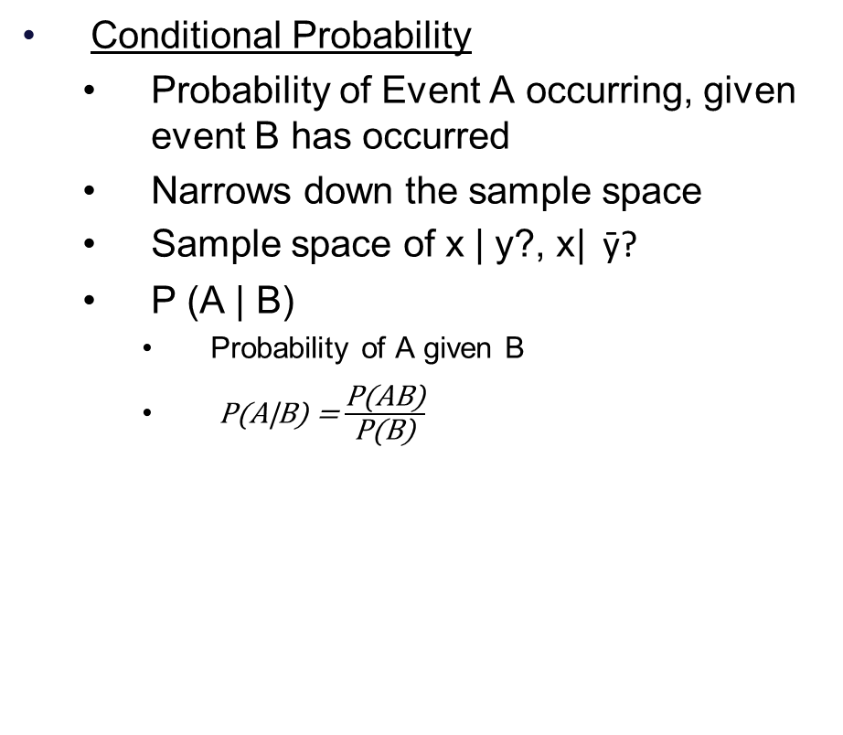
Conditional Probability
Conditional Probability
Probability of Event A occurring, given event B has occurred
Narrows down the sample space
Sample space of x | y?, x| ȳ?
P (A | B)
Probability of A given B
P(A|B) = $\frac{\text{P}\text{(}\text{AB}\text{)}}{\text{P}\text{(}\text{B}\text{)}}$
Contingency Table
Probability of “actual purchase” given “plans to purchase”
P(x| y) = p (x ∩ y) / p (y)
= (200/1000) / ( 250/1000)
= 200 /250 = .8
Probability of “purchasing” given “does not plan to purchase”
P(x| ȳ ) = p (x ∩ ȳ) / p (ȳ)
= (100/1000) / ( 750/1000)
= 100 /750 = 0.133
Also can be computed from
the new narrowed sample space
Sample space of x | y? and x| ȳ?
P(x| y) = 200 /250 = .8
P(x| ȳ ) = 100 /750 = 0.133

Slide 8
Conditional Probability and sample space
Total
1000
Probability of “actual purchase” given “plans to purchase”
From narrowed sample space
= 200 /250 = .8
Plans to purchase
250
Does not plan to purchase
750
Purchase: Yes
200
Purchase: No
50
Purchase: Yes
100
Purchase: No
650

Slide 9
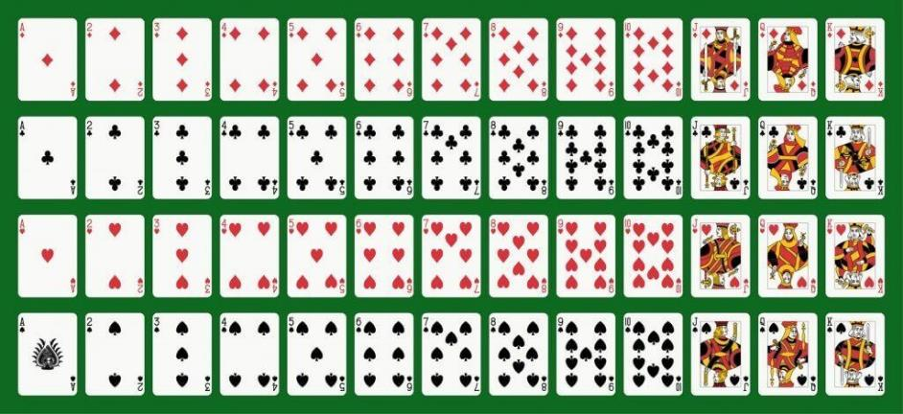
Marginal, Joint and Conditional probability
P(Red | King)
= ½= 2/4
P(Red | 7)
=1/2
P(Picture | Black)
6/26
P(Picture | Diamond)
3/13
Diamond
Club
Heart
Spade
Conditional probability- P(King | Red) means the probability that the card is a King given that you have the information that the card is a Red Card

Slide 10
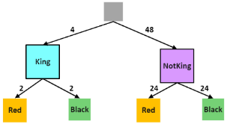
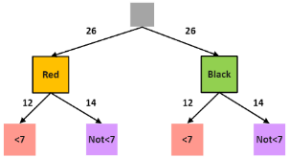
Conditional probability
From 52 card deck
P(Red |King)= 2/4.
P(Red |8)=2/4.
P(Picture |Red)=6/26.
P(Picture |7)=0/4.
P(=7|Red)= 2/26.
P(<7|Red)= 12/26.
P(<7|Diamond)= 6/13.
P(Picture|Red)=6/26.
P(Red|Picture)= 6/12.
P(Red|Diamond)=13/13 = 1.
P(Diamond|Red)= 13/26.
Diamond
Club
Heart
Spade
Frequencies on tree
Contingency table
P(Red|King): If the card is a King, what is the probability it is of Red color? 2/4=1/2.
P(<7/Red): If the card is of Red color, what is the probability it is <7? 12/26.

Slide 11

Application of Conditional Probability
Issue of Credit card using P(Default | Event)
Do you own a house?
Are you a working professional?
Do you have a PAN card?
Is your CIBIL score higher than 800?
Do you have a credit card from another bank?
Insurance Premium Decisions P( Claim | Event)
P ( Lung Cancer | Smokes)
P (Lung Cancer | Does not smoke)
P (Death in the insurance period | Age 1-50)
P (Death in the insurance period | Age 80+)

Slide 12
Application of Conditional Probability
Medical diagnosis
Narrowing down the probability of the patient having diabetes
P (Diabetes)
The doctor asks several questions
Do you urinate a lot?
P(HasDiabetes | UrinateALot) = a.
P(HasDiabetes | DoesNotUrinateALot) = b
Subsequent questions can further narrow down the probabilities

Slide 13
Independence
Independence
Events A and B are independent if
Information about one event having occurred does not help narrow down the sample space
P (A | B) = P (A) ;
‘|’ is read as: “conditional on” or “given”
Are “Purchase” and “Plans to Purchase” independent events?
Toss of a coin - Are head and tail independent events?
What is the probability P(Head)?
What is the probability of getting a “Head” if you know that “Tail” has occurred?
Zero
Hence they are not independent
Total
1000
Plans to purchase
250
Does not plan to purchase
750
Purchase: Yes
200
Purchase: No
50
Purchase: Yes
100
Purchase: No
650
P(purchase)?
P(purchase | plans to purchase)?
P(purchase) = 300/1000 = 0.3 = 30%
P(purchase | plans to purchase) = 200/250
= 0.8 = 80%

Slide 14

Multiplication Rule
Joint Probability
P(A|B) = $\frac{\text{P}\text{(}\text{AB}\text{)}}{\text{P}\text{(}\text{B}\text{)}}$
P(AB) = P (A|B).P(B)
Note: P(AB )= P(A and B) = P(A∩B)
For Independent Events
P(A | B) = P(A)
P(A and B) = P(A). P(B)
For a toss of a fair coin.
What is the probability of getting
4 heads in a row?
P(Head) = P(H) = ½
4 tosses are 4 independent events
P( H, H, H, H) = P(H).P(H).P(H).P(H)
= (1/2)⁴
= 1/16

Slide 15
Multiplication Rule and marginal probability
Marginal probability and general multiplication rule
If, P(A) = P(A∩B1) + P(A∩B2) + …… + P(A∩Bn)
A always takes place with one of the mutually exclusive events B1, B2, …., Bn
Then, P(A) = P(A|B1).P(B1) + P(A|B2).P(B2) + …… + P(A|Bn).P(Bn)
P(Purchased) =
P(Purchased | Planned:Yes)* P (Planned:Yes)
+
P(Purchased | Planned:No)* P (Planned:No)
p(x) => (200/250)*(250/1000) + (100/750)*(750/1000) = 0.3
Contingency Table

Slide 16
Multiplication Rule and marginal probability
Marginal probability and general multiplication rule
If, P(A) = P(A∩B1) + P(A∩B2) + …… + P(A∩Bn)
Then, P(A) = P(A|B1).P(B1) + P(A|B2).P(B2) + …… + P(A|Bn).P(Bn)
Total
1
Marginal Probability P(Purchased) =
P(Purchased | Planned:Yes) * P (Planned:Yes)
+
P(Purchased | Planned:No) * P (Planned:No)
Plans to purchase
0.25
Does not plan to purchase
0.75
P (purchased) = 0.8*0.25 + 0.133*0.75 = 0.3
Purchase: Yes
0.8
Purchase: No
0.2
Purchase: Yes
0.133
Purchase: No
0.867

Slide 17
Bayes’ Theorem
P (B|A) when P(A|B) is known
From P(B|A) to P (A|B)
From P(Test is positive | Covid) to => P ( Covid | Test is positive)
Updating estimated probability after actual experience
You started with assuming the coin has 50% chance of being fair i.e. P(Coin-Fair) = .5
You see three tosses showing up as Heads
You would like to update your probability estimates
P (Coin-Fair | Three-Heads-In-A-Row)

Slide 18
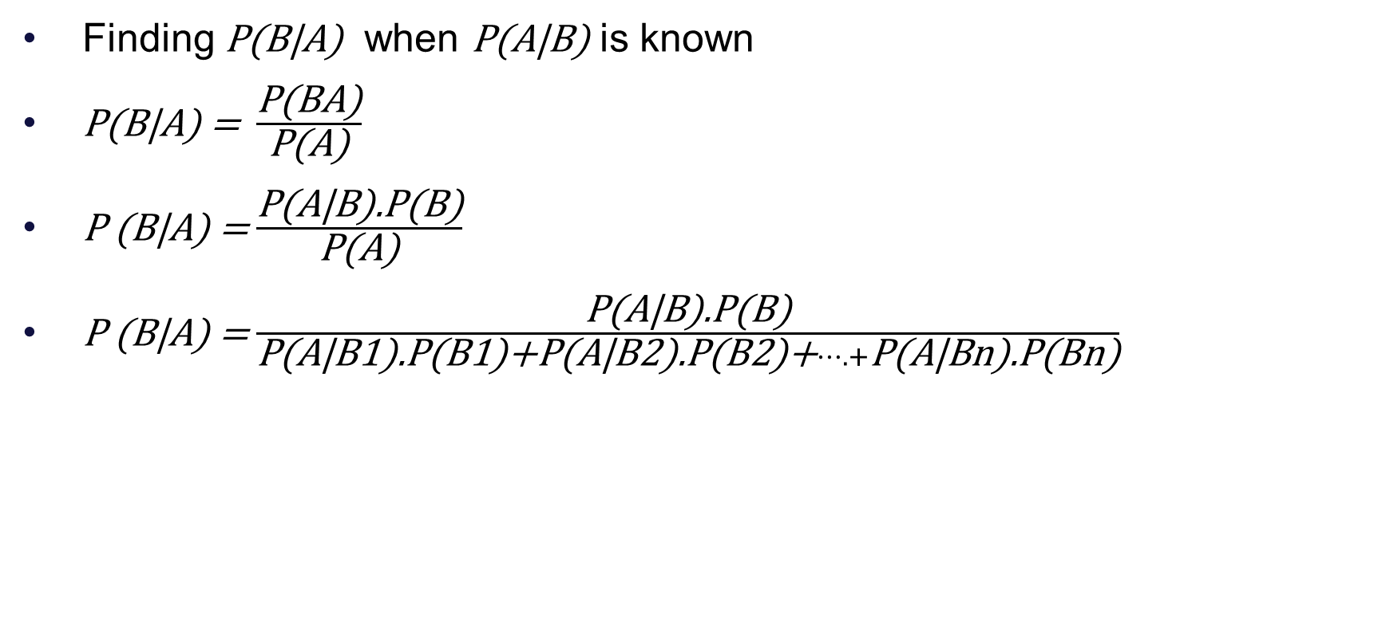
Bayes’ Theorem
Finding P(B|A) when P(A|B) is known
P(B|A) = $\frac{\text{P}\text{(}\text{BA}\text{)}}{\text{P}\text{(}\text{A}\text{)}}$
P (B|A) = $\frac{\text{P}\text{(}\text{A}\text{|}\text{B}\text{).}\text{P}\text{(}\text{B}\text{)}}{\text{P}\text{(}\text{A}\text{)}}$
P (B|A) = $\frac{\text{P}\text{(}\text{A}\text{|}\text{B}\text{).}\text{P}\text{(}\text{B}\text{)}}{\text{P}\text{(}\text{A}\text{|}\text{B}\text{1).}\text{P}\text{(}\text{B}\text{1)+}\text{P}\text{(}\text{A}\text{|}\text{B}\text{2).}\text{P}\text{(}\text{B}\text{2)+}….+\text{P}\text{(}\text{A}\text{|}\text{Bn}\text{).}\text{P}\text{(}\text{Bn}\text{)}}$

Slide 19
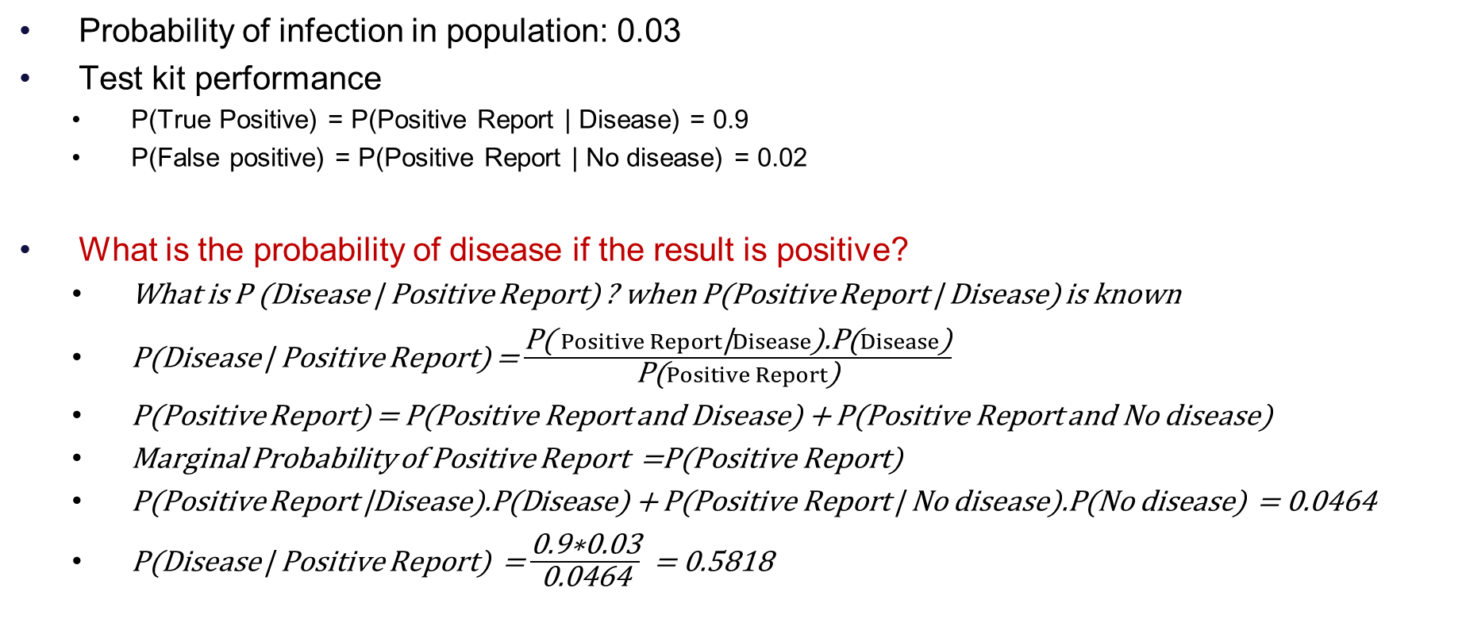
Bayes’ Theorem
D
Probability of infection in population: 0.03
Test kit performance
P(True Positive) = P(Positive Report | Disease) = 0.9
P(False positive) = P(Positive Report | No disease) = 0.02
What is the probability of disease if the result is positive?
What is P (Disease | Positive Report) ? when P(Positive Report | Disease) is known
P(Disease | Positive Report) = $\frac{\text{P}\text{( }Positive Report\text{|}Disease\text{).}\text{P}\text{(}Disease\text{)}}{\text{P}\text{(}Positive Report\text{)}}$
P(Positive Report) = P(Positive Report and Disease) + P(Positive Report and No disease)
Marginal Probability of Positive Report =P(Positive Report)
P(Positive Report |Disease).P(Disease) + P(Positive Report | No disease).P(No disease) = 0.0464
P(Disease | Positive Report) = $\frac{\text{0.9∗0.03}}{\text{0.0464}}$ = 0.5818
Y: 0.03
N:0.97
TP: 0.9
FN: 0.1
TN: .98
FP: 0.02

Slide 20
CW/HW-1
Identify Worst Economist
The track record of four economists in predicting the economy is given in the contingency tables.
The track record of four astrologers in predicting whether Indian football team will win (replace Up with Win) or lose (replace Down with Lose) is given in the contingency tables.
Identify the worst economist?
Rank all economists and show all calculations. Hint: Use conditional probability.
A
B
C
D

Slide 21
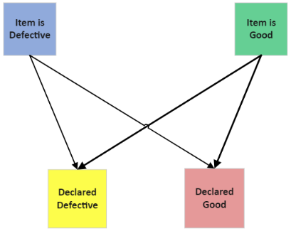
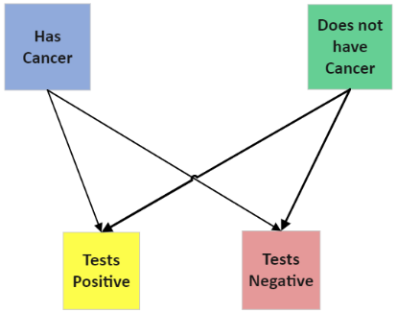

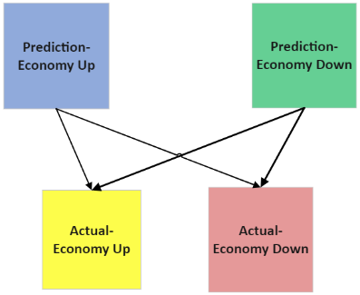
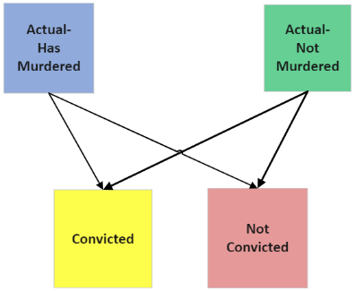
Imperfect ‘classification machines’
Quality inspection
Medical diagnosis
Banks
Economists/Astrologers

Slide 22
Some other applications
C
Updating apriori probabilities based on experience/evidence
Is the coin fair?
You start with 0.5 probability of coin being fair:
P(H) = P(T) = 0.5
An unfair coin is assumed to give heads 80% of the time
What is your updated probability estimate of the coin being fair, if you see 2 heads in a row?
P(HH|F) = 0.25, P(HH|U) = 0.64, P(F|HH)?
P(F|HH) = P(HH|F)*P(F) / P(HH)
P(HH) = P(HH|F)*P(F) + P(HH|U)*P(U)
0.25*0.5/(0.125 + 0.32) = 0.125/0.445 = 0.280
Updated priors P(F) = 0.28, P(U) = 0.72
F: 0.5
U:0.5
HH: 0.25
NHH: 0.75
HH: 0.64
NHH: 0.36

Slide 23
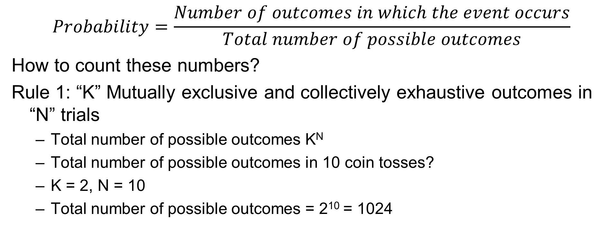
Counting Methods (1/4)
$$Probability=\frac{Number of outcomes in which the event occurs}{Total number of possible outcomes}$$
How to count these numbers?
Rule 1: “K” Mutually exclusive and collectively exhaustive outcomes in “N” trials
Total number of possible outcomes K^{N}
Total number of possible outcomes in 10 coin tosses?
K = 2, N = 10
Total number of possible outcomes = 2¹⁰ = 1024

Slide 24
Counting Methods (2/4)
Rule 2: IF there are “K1” possible outcomes in 1st trial, K2 in 2nd and so on
Total number of possible outcomes = K1*K2*….
Example:
Possible number plates if the number consists of 2 alphabets followed by 2 numbers?
26*26*10*10 = 67600

Slide 25
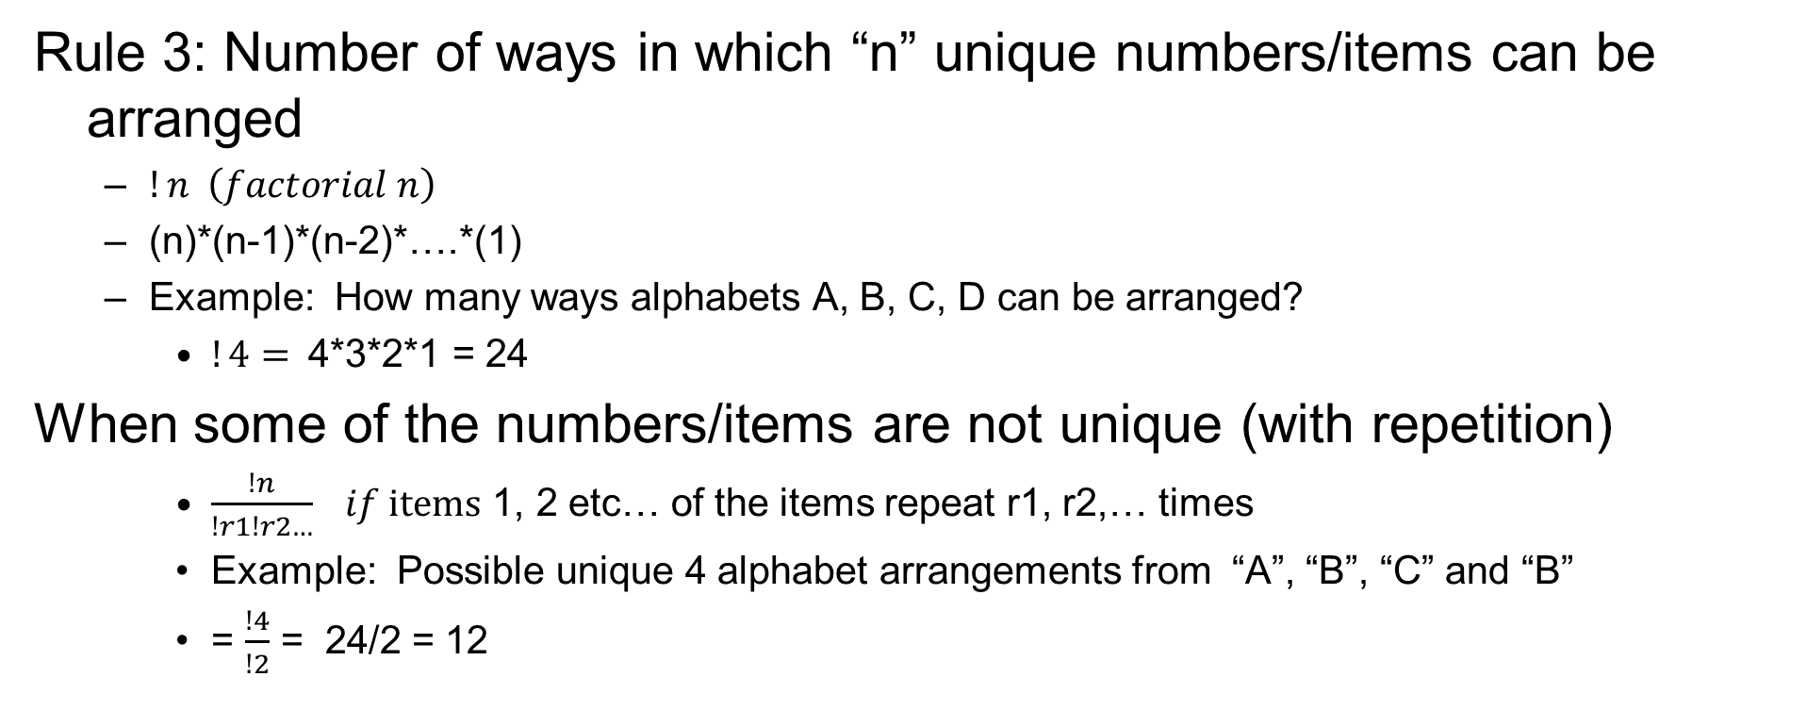
Counting Methods (3/4)
Rule 3: Number of ways in which “n” unique numbers/items can be arranged
$!n \left(factorial n\right)$
(n)*(n-1)*(n-2)*….*(1)
Example: How many ways alphabets A, B, C, D can be arranged?
$!4=$4*3*2*1 = 24
When some of the numbers/items are not unique (with repetition)
$\frac{!n}{!r1!r2…} if items$ 1, 2 etc… of the items repeat r1, r2,… times
Example: Possible unique 4 alphabet arrangements from “A”, “B”, “C” and “B”
= $\frac{!4}{!2}$ = 24/2 = 12

Slide 26
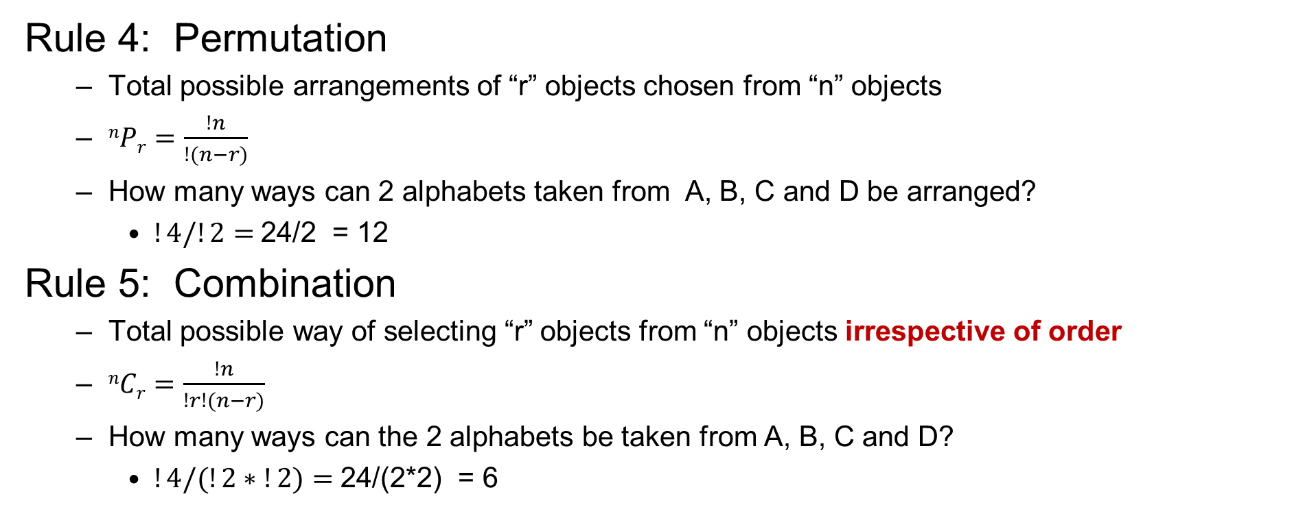
Counting Methods (4/4)
Rule 4: Permutation
Total possible arrangements of “r” objects chosen from “n” objects
$nPr=\frac{!n}{!(n−r)}$
How many ways can 2 alphabets taken from A, B, C and D be arranged?
$!4/!2=$24/2 = 12
Rule 5: Combination
Total possible way of selecting “r” objects from “n” objects irrespective of order
$nCr=\frac{!n}{!r!(n−r)}$
How many ways can the 2 alphabets be taken from A, B, C and D?
$!4/(!2∗!2)=$24/(2*2) = 6

Slide 27
Situated Learning Assignment (3 Marks)
Take a data from your work context
Identify datascale of different variables
Nominal, ordinal, interval, ratio
Compute measures of central tendency and dispersion
Arithmetic mean
Dispersion: Next slide
Calculations: By hands (calculator is allowed but not MS XL)
Suitable graphs (using MS XL)
Depends on variable types
For interval and ratio with histograms
You can comment about skewness and kurtosis

Slide 28
Measuring variation
Range = Maximum-Minimum
Variance, population = σ² = 1/N * ∑ (x_{i}-Mean)²
Standard deviation, population = σ
Coefficient of Variation, population = σ/Mean
Variance, sample = s² = 1/(N-1) * ∑ (x_{i}-Mean)²
Standard deviation, sample = s
Coefficient of Variation, sample = s/Mean
Mean absolute deviation = 1/N * ∑ |x_{i}-Mean|
Z score (how many std devns is xi
away from the mean) = [x_{i}-Mean]/ σ
Quartiles (Q₁, Q₂, Q₃) Smallest 25%, 50%, 75% observations.
Inter-quartile range = Q₃ – Q₁
5-number summary (Min., Q₁, Q₂, Q_{3,} Max.) Minimum, 3 Quartiles, Maximum
Boxplot (Called Box and Whisker chart in MS Excel) Plot of 5-number summary

Slide 29
Assignment Reporting Example
How to calculate manually and report
5 points summary of dataset { 10, 20, 30, 40, 50, 60}
Min: 10
Q1: (n+1)/4th number = 7/4tg = 1.75th = 10 + (20-10)*0.75 = 17.5
Q2 = (n+1)/2th number = 7/2th = 3.5th = 35
Q3 = (3/4)*(n+1)th = 5.25th = 52.5
Max: 60
5 Point summary = { 10, 17.5, 35, 52.5, 60}
You can use XL for graphs and to verify your results

Slide 30
Q&A

